Slide 1

ABC Call Volume Trend Analysis
A Project Report by J. Athreya Sharma

Slide 2

Cleaning
The given data contains many null values and unnecessary columns by using the filter function I have removed the blank and N/A values after removing the data you can find the below the data set link
The given data set link
The data after cleaning

Slide 3

Task 1:- Calculate the average call time duration for all incoming calls received by agents (in each Time_Bucket).
Project Description:- The given task is about to Calculate the average call time duration for all incoming calls received by agents (in each Time_Bucket).
Approach:-To calculate the average call time duration I have taken the 3 columns from the data set i.e time bucket ,call seconds and call status by using the pivot table in rows I have taken time bucket in columns I have taken average of call second and in filter I have taken the cell status and filtered only answers calls you can find the graph.

Slide 4


Continue
Tech-Stack Used :- I have used Microsoft excel / google sheets to solve.
Insights :- In the Throughout the data, the total average call time duration for calls answered by the agents is calculated to be 198.6 seconds. Further analysis reveals that the average call time duration for incoming calls received by agents is highest between 10 am to 11 am and from 7 pm to 8 pm.
Result:- Average call time duration.

Slide 5
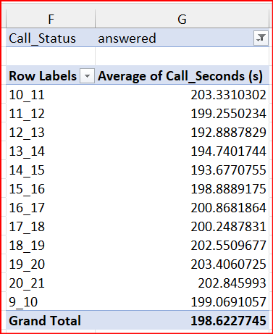

Slide 6

Task 2:-Show the total volume/ number of calls coming in via charts/ graphs [Number of calls v/s Time]. You can select time in a bucket form (i.e. 1-2, 2-3, …..)
Project Description:- The task is given to Show the total volume/ number of calls coming in via charts/ graphs [Number of calls v/s Time]. You can select time in a bucket form (i.e. 1-2, 2-3, …..)
Approach:- To solve the task I have take time bucket call seconds and customer phone number by using the pivot table I have dropped the time bucket in rows , call seconds in the value and I have found the count for two time for call seconds which came the same value so I have converted the call seconds volume into the %column percentage and drawn the graph you can find in next slide .

Slide 7

Continue
Insights:-Based on the analysis, it was observed that customers make the highest number of calls between 11 am to 12 noon. This time period sees the highest customer engagement and interaction.On the other hand, the analysis also revealed that customers make the least number of calls between 8 pm to 9 pm. During this time, there is a decrease in customer call activity, possibly due to various factors such as dinner time or reduced availability of customer service.
Result:- total volume/ number of calls

Slide 8
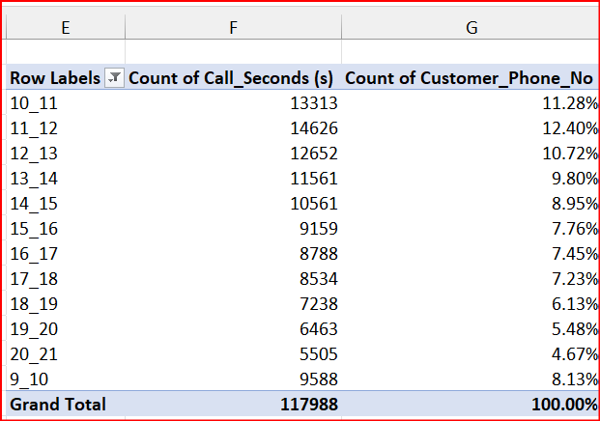

Slide 9

Task 3:-As you can see current abandon rate is approximately 30%. Propose a manpower plan required during each time bucket [between 9am to 9pm] to reduce the abandon rate to 10%. (i.e. You have to calculate minimum number of agents required in each time bucket so that at least 90 calls should be answered out of 100.)
Project Description:- The is given that As you can see current abandon rate is approximately 30%. Propose a manpower plan required during each time bucket [between 9am to 9pm] to reduce the abandon rate to 10%. (i.e. You have to calculate minimum number of agents required in each time bucket so that at least 90 calls should be answered out of 100.)

Slide 10

Continue
Approach:-The question is the combination of two question so I have divided into two parts . The first part is I have calculated the average call second count of customer and count of call seconds by using the pivot table by taking the duration, call seconds, call status and customer phone number columns from the given data . Here you can find the answered calls are more when compared to other two categories . You can find the graph also
After that they have asked to find the minimum number of agents required for that I have taken 3 columns date and time, call seconds and time bucket . I have converted the date and time to the date and month format i.e 21-01-2022 to 21-jan by using the ctrl + shift + 3.

Slide 11

Continue
Now by using the pivot table I have counted the relation between the count of call seconds and time bucket and for that I have calculated the agent required by using the formula =ROUND(H8*56,0)
Next in the same sheet I have calculated the sum of call seconds by using the time bucket and call seconds on 1-1-2022
By finding the sum we can find sum of hour by dividing by 3 . Total agent required for the 60 % is by diving sum of hour by 5. for 90 % by 60 %/60*90.

Slide 12

Continue
Insights:-Therefore, the total number of agents needed to achieve a 90% call connection rate is approximately 56.
Result:- to calculate the man power
min number of agents required

Slide 13
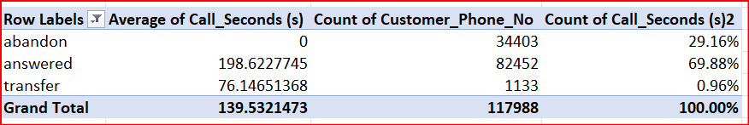

Slide 14
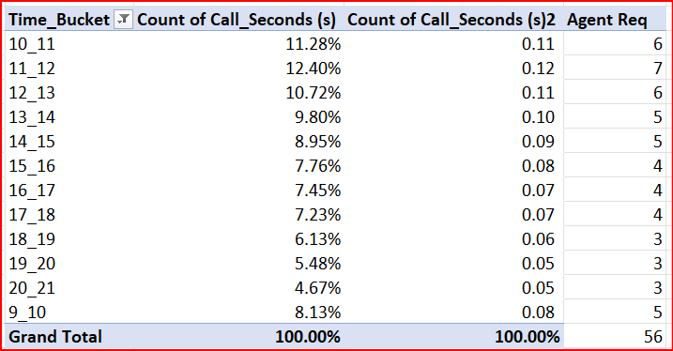
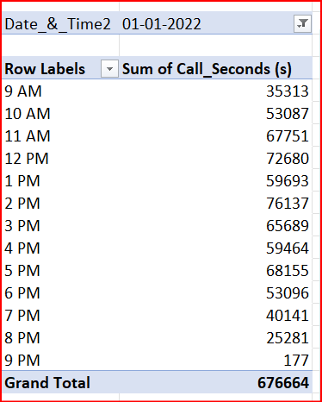
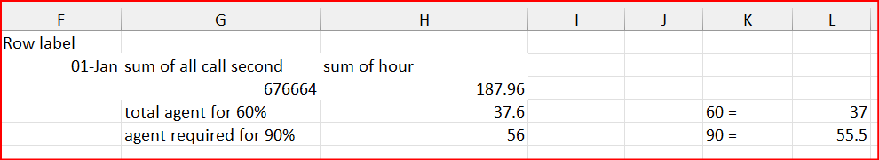

Slide 16
Task 4:-Let’s say customers also call this ABC insurance company in night but didn’t get answer as there are no agents to answer, this creates a bad customer experience for this Insurance company. Suppose every 100 calls that customer made during 9 Am to 9 Pm, customer also made 30 calls in night between interval [9 Pm to 9 Am] and distribution of those 30 calls are as follows: Now propose a manpower plan required during each time bucket in a day. Maximum Abandon rate assumption would be same 10%.

Slide 17

Continue
Approach:- First I have calculated the call distribution to calculate this I have used pivot table in that I have taken time bucket call distribution .. Etc columns and drawn a graph for this .
Next by using the pivot table only I have calculated by taking date in rows count of call status in values and call status in the columns and drawn a graph for this . After calculation the average call daily is 5130 for the night it is calculated by using the formula =5130*30% the addition hours is calculated by =ROUND(N4*198.6*0.9/3600,0) and additional agent required is calculated by =ROUND(N6/5,0).

Slide 18

Continue
Insights:-By adjusting the shift timings of the employees, such as having some workers from 5 am to 2 pm and others from 2 pm to 11 pm, the company can maximize the number of calls answered during peak hours. To ensure round-the-clock availability, the company can divide its workforce into three shifts, enabling agents to be available 24/7 for addressing customer queries and concerns. It is important to note that during the analysis, outliers were identified in the data. Removing these outliers could potentially lead to different outcomes and answers, as they may have influenced the results.
Result:- Call Distibution
Total number of agents required

Slide 19
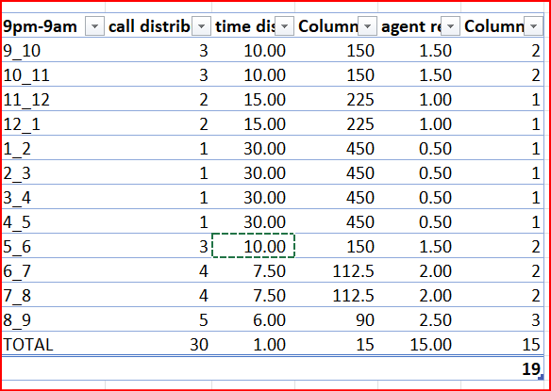
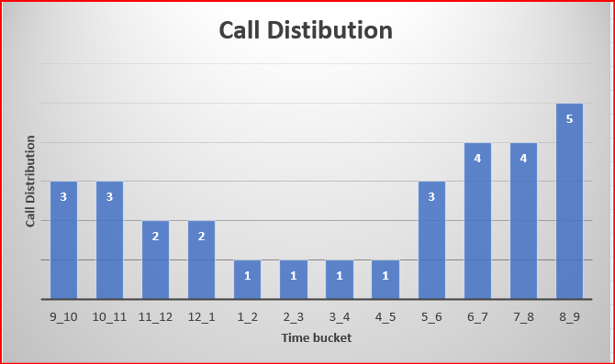

Slide 20
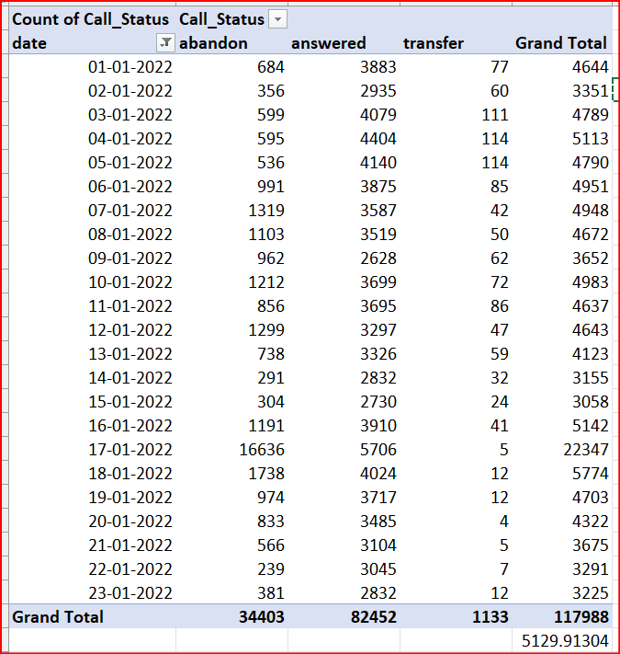
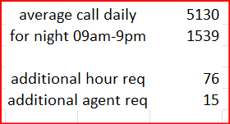

Slide 22
Drive link:- Abs call volume pdf Google sheet link:- Abs call volume trend loom video

Slide 23

Thank you

